Slide 1
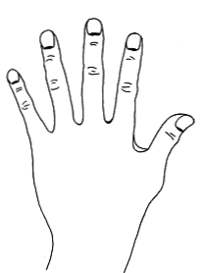
Setup Statement
While tapping the side of hand point:
“Even though I have this anxiety/fear/phobia, I deeply and completely accept myself.”
Repeat twice more.
SH – side of hand
Small Intestine, SI 3

Slide 2
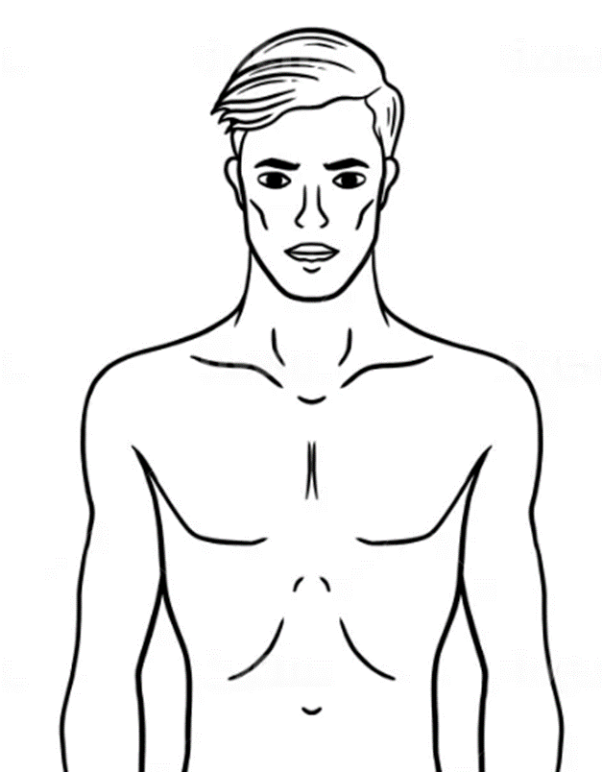
Anxiety Algorithm
Sequence Bridge Sequence
ue
Nine Gamut
uc
ua

Slide 3
9-Gamut Bridging Technique

Slide 4
Floor to ceiling eye roll
While tapping back of hand: Close eyes, open eyes, look way down, slowly roll eyes straight up and back along the ceiling, gently flutter eyes closed, take a deep breath, open eyes when you’re ready.

